Slide 1
ESSA School Index Reports
February 2018

Slide 2
Rigorous Academic Standards

Slide 3
Grade Bands | Assessment | State Use
3–8 | ACT Aspire® | Achievement and Growth • English Language Arts (English, reading, writing) • Mathematics • Science (5th indicator)
9–10 | ACT Aspire® | Achievement and Growth • English Language Arts (English, reading, writing) • Mathematics • Science (5th indicator)
Alternate Assessment for Significantly Cognitively Disabled Students | Multi-State Alternative Assessment 2017-2018 Arkansas Alternate Portfolio Assessment Dynamic Learning Maps under consideration for 2018 and forward | Multi-State Alternative Assessment (MSAA) • English Language Arts (English, reading, writing) • Mathematics Arkansas Alternate Portfolio Assessment • Science portfolio Dynamic Learning Maps • English Language Arts, grades 3–10 • Math, grades 3–10 • Science, grades 3–10
11 | The ACT® | Achievement and Growth • Percent meeting Readiness Benchmark
K-12 | English Language Proficiency Assessment for 21st Century (ELPA21) | • Percent meeting Readiness Benchmark
Strong State Assessment System

Slide 4
What is the ESSA School Index? The Every Student Succeeds Act (2015) provided states the opportunity to engage stakeholders in the development of the state’s accountability system. ESSA required states to include at least five indicators for success: 1. Achievement, 2. Growth, 3. English learner progress toward English language proficiency, 4. Graduation rate, and 5. School quality and student success (SQSS)
Stakeholder Designed Accountability System

Slide 5
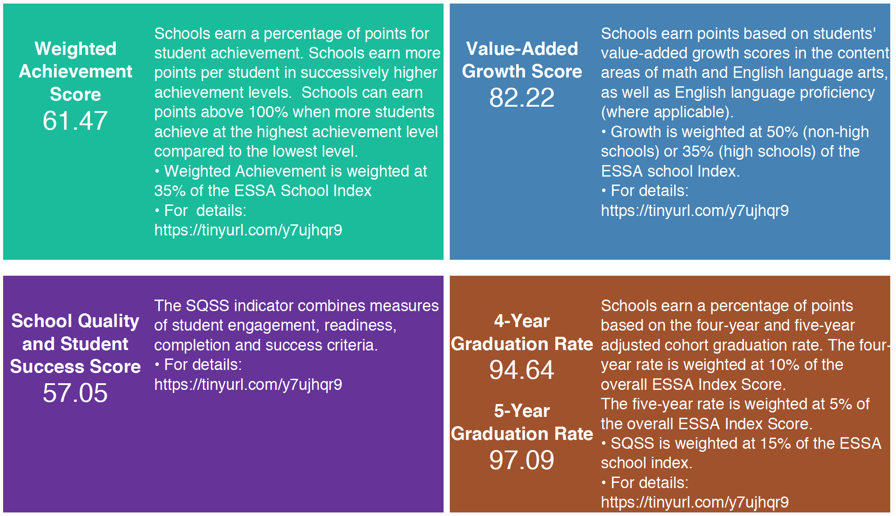

Slide 6
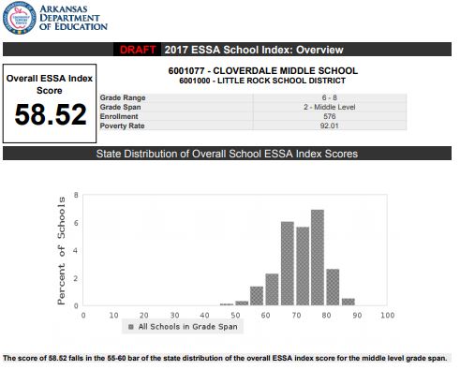

Slide 7
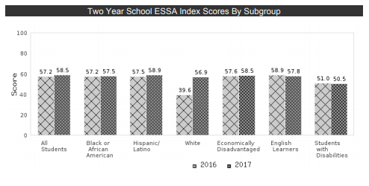
CLOVERDALE

Slide 8
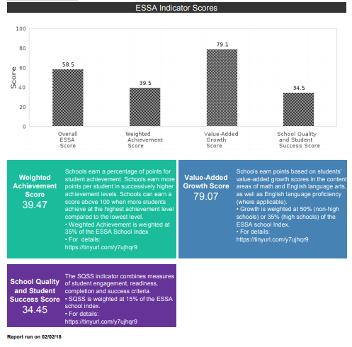
CLOVERDALE

Slide 9
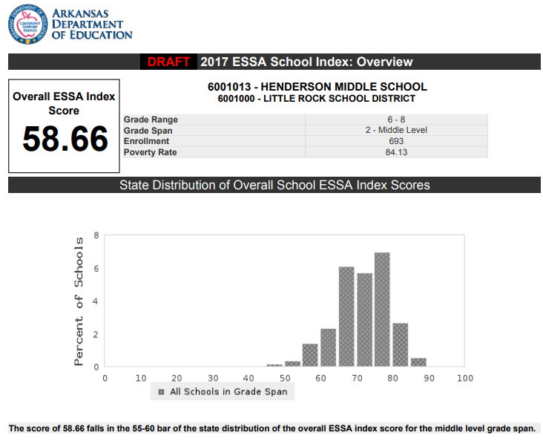

Slide 10
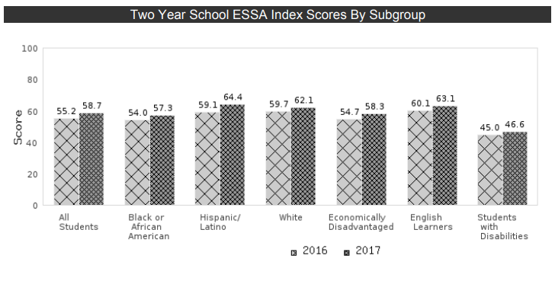
HENDERSON

Slide 11
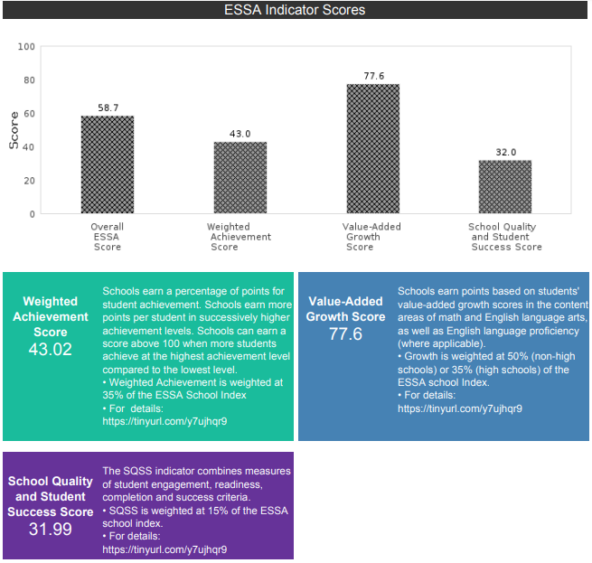
HENDERSON

Slide 12
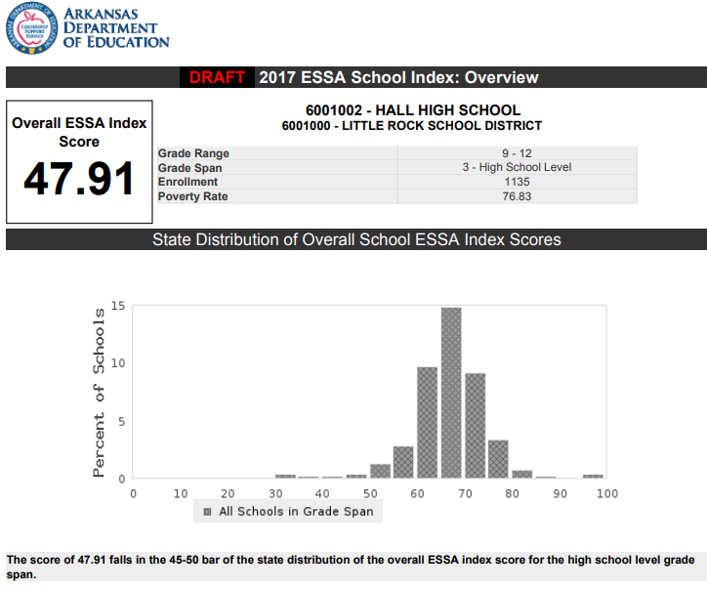

Slide 13
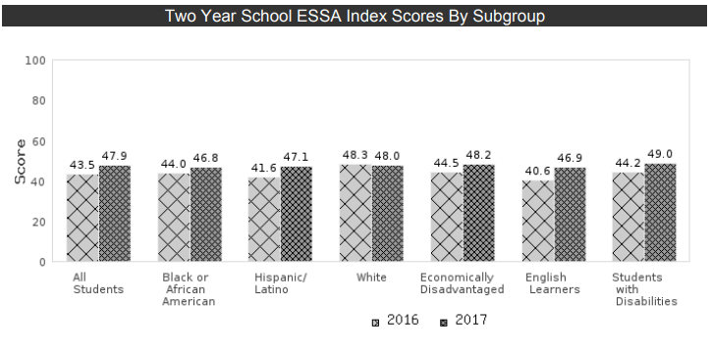
HALL

Slide 14
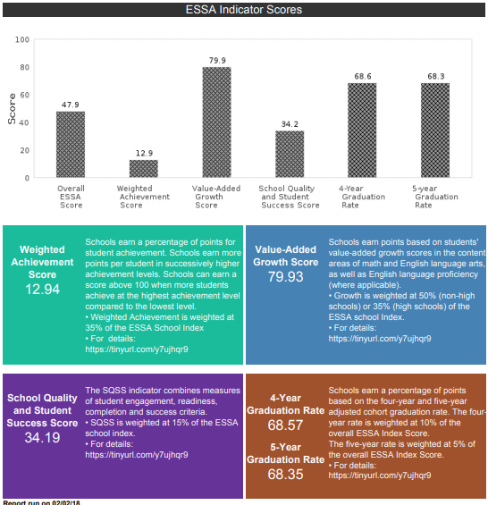
HALL

Slide 15
Thank You!

